Slide 1
Solution of Non- homogeneous system of linear equations using Genetic Algorithm
Presented by: Asma Javaid, Aafia Jabeen
Course: Evolutionary Computing

Slide 2
Outline
Previous Work/ Introduction
Current Work/ Problem
Genetic Algorithm Methodology
Comparison
Analysis/ Conclusion

Slide 3

..
$$a_{11}x_{1}+ a_{12}x_{2}+………………. a_{1n}x_{n}=b_{1}$$
$$a_{21}x_{1}+ a_{22}x_{2}+………………. a_{2n}x_{n}=b_{2}$$
$$a_{31}x_{1}+ a_{32}x_{2}+………………. a_{3n}x_{n}=b_{3}$$
.
.
.
$a_{m1}x_{1}+ a_{m2}x_{2}+………………. a_{mn}x_{n}=b_{m}$.
We are non-homogeneous system of equation which are diagonally dominant that is |$a_{ii}$|$≥$|$a_{ij}$|.

Slide 4
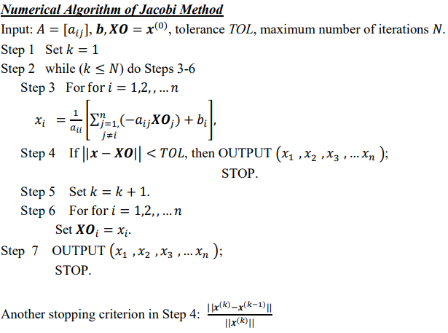
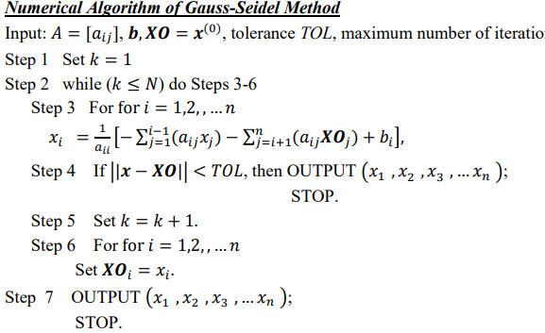
Previous work
In past few years many well known mathematical direct and indirect approaches have been introduced to solve system of linear equations e.g. Gauss Elimination Method, Gauss Jordon Method, Jacobi and Gauss Seidal method. Later two methods are the iterative methods and have been widely used when we have more then one equation.

Slide 5
Simon Mardle and Sean Pascoe 1999, An overview of genetic algorithms for the solution of optimization problems.
Solve one Linear Equation using Evolutionary Algorithm written by Lubna Zaghlul Bashir and publish in World Scientific News.
have been widely used when we have more then one equation

Slide 6
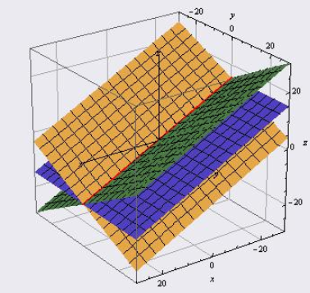

Current Work/ Problem
In this project we are using the concept of Genetic Algorithm to find solution for the set of non homogeneous system of linear equations instead of one linear equation and compared our solution to existing algorithms.
$$a_{11}x_{1}+ a_{12}x_{2}+ a_{13}x_{3}=b_{1}$$
$$a_{21}x_{1}+ a_{22}x_{2}+a_{23}x_{3}=b_{2}$$
$$a_{31}x_{1}+ a_{32}x_{2}+ a_{33}x_{3}=b_{3}$$

Slide 7
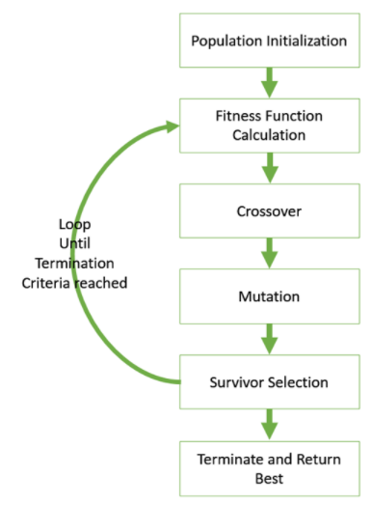
Methodology for G.A

Slide 8
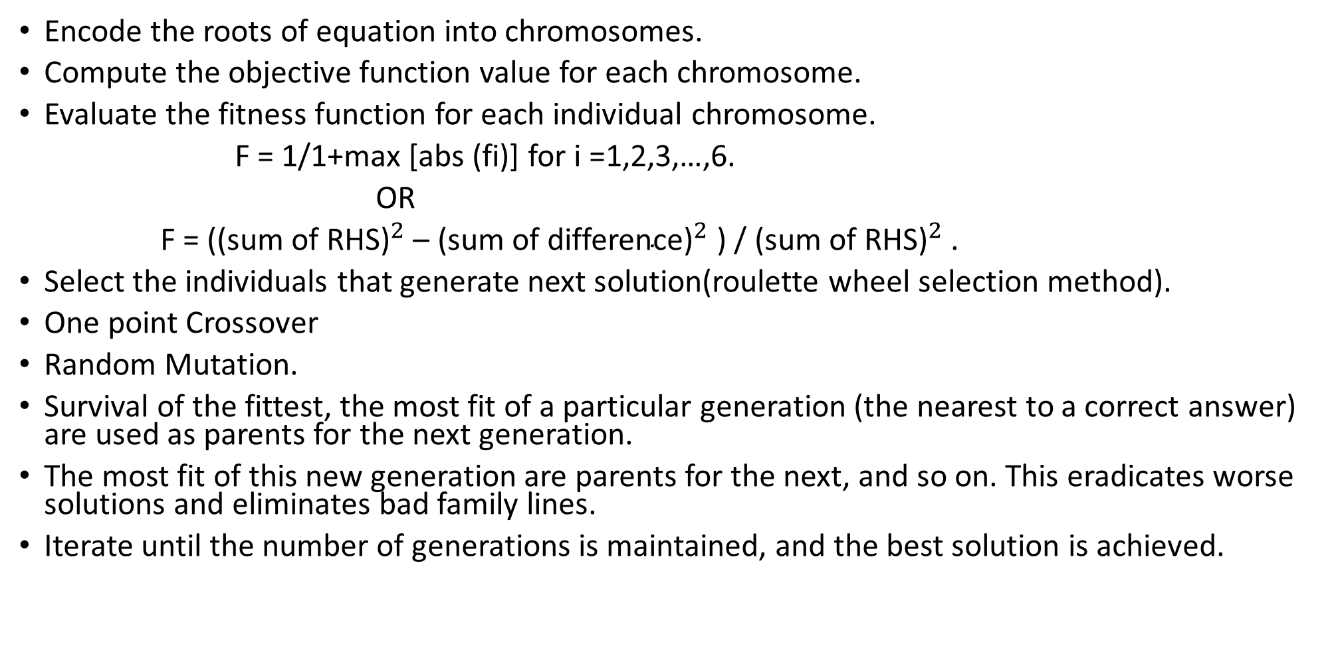
PROCEDURE ADOPTED FOR FINDING THE ROOTS OF NON HOMOGENEOUS LINEAR SYSTEM
Encode the roots of equation into chromosomes.
Compute the objective function value for each chromosome.
Evaluate the fitness function for each individual chromosome.
F = 1/1+max [abs (fi)] for i =1,2,3,…,6.
OR
F = (${\text{(}\text{sum} \text{of} \text{RHS}\text{)}}^{2}$ – ${\text{(}\text{sum} \text{of} \text{difference}\text{)}}^{2}$ ) / ${\text{(}\text{sum} \text{of} \text{RHS}\text{)}}^{2}$ .
Select the individuals that generate next solution(roulette wheel selection method).
One point Crossover
Random Mutation.
Survival of the fittest, the most fit of a particular generation (the nearest to a correct answer) are used as parents for the next generation.
The most fit of this new generation are parents for the next, and so on. This eradicates worse solutions and eliminates bad family lines.
Iterate until the number of generations is maintained, and the best solution is achieved.

Slide 9

.
6$x_{1}+ x_{2}+x_{3}=105$
${4x}_{1}+8x_{2}+{3x}_{3}=155$
5$x_{1}+ {4x}_{2}+10x_{3}=65$
Initial Population | Fitness function | prob | crossover | mutation
2,3,5 | 0.9954 | 0.3986 | 8,9,2 | 8,9,2
2,8,1 | 0.4710 | 0.1886 | 3,6,6 | 3,6,8
3,5,4 | 0.1317 | 0.0527 | 7,4,1 | 7,4,1
1,6,8 | 0.5988 | 0.3599 | 5,4,6 | 5,4,6
7,4,6 | 0.4376 | 0.2643 | 3,6,8 | 3,8,5
3,1,9 | 0.3273 | 0.4671 | 2,5,2 | 2,5,9
5,4,1 | 0.2476 | 0.3571 | 3,5,1 | 3,5,1
1,4,2 | 0.1321 | 0.2168 | 2,8,4 | 2,8,4
3,6,2 | 0.3576 | 0.2764 | 2,3,8 | 2,3,6
2,5,8 | 0.3762 | 0.5235 | 2,6,5 | 2,6,5
8,9,6 | 0.8745 | 0.3675 | 3,5,9 | 3,5,7
3,5,4 | 0.1317 | 0.0527 | 3,1,4 | 3,1,4
2,6,8 | 0.8988 | 0.1486 | 2,8,2 | 2,6,8

Slide 10
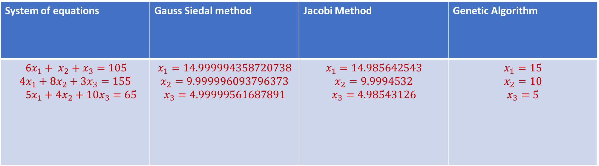
Comparison with Existing Algorithms
System of equations | Gauss Siedal method | Jacobi Method | Genetic Algorithm
6$x_{1}+ x_{2}+x_{3}=105$ $$4x_{1}+8x_{2}+{3x}_{3}=155$$ 5$x_{1}+4x_{2}+10x_{3}=65$ | $$x_{1}=14.999994358720738$$ $$x_{2}=9.999996093796373$$ $$x_{3}=4.99999561687891$$ | $$x_{1}=14.985642543$$ $$x_{2}=9.9994532$$ $$x_{3}=4.98543126$$ | $$x_{1}=15$$ $$x_{2}=10$$ $$x_{3}=5$$

Slide 11
Conclusion
In this project we observed that the Genetic Algorithm (GA) equation solver can find all possible sets of solutions. These solutions are applicable to any given set of simultaneous linear equations.
However genetic algorithm takes more generations then numerical algorithms but it gives us exact solution for given system of equations.

Slide 12
References
Bashir, L.Z., 2015. Solve Simple Linear Equation using Evolutionary Algorithm. World Scientific News, 19, pp.148-167.
Mardle, S. and Pascoe, S., 1999. An overview of genetic algorithms for the solution of optimisation problems. Computers in Higher Education Economics Review, 13(1), pp.16-20.
Grosan, C. and Abraham, A., 1996. Solving nonlinear equation systems using evolutionary algorithms. In Proceedings of genetic & evolutionary computation conference, Seattle, USA, Proceedings on CD.

Slide 13
Questions?

